Slide 1
Change Point Detection Project Proposal
Adam Yang
4/21/2022

Slide 2
Motivation
Problem: Large list of parameters that are not manually monitored
Automate a way to detect change points in unmonitored list of parameters
Vision: Flag all change points that occurred each month, hand them off to experts for manual review

Slide 3
Current Working Version
Charles Truong created the “ruptures” python package that includes the change point search algorithm that I use
Truong, C., Oudre, L., & Vayatis, N. (2020). Selective review of offline change point detection methods. Signal Processing, 167.
Pruned Exact Linear Time (PELT) search method
Search for a point in the trend that minimizes the cost function meanwhile pruning away points that could never be the change point
O(N) implementation where N is the the number of datapoints per parameter
Current working version inputs list of parameters from CSV files
2745 M1 Parameters
2529 M5 Parameters
4479 MF Parameters
208 IQC Metrology Parameters
Iterates process over each parameter:
Pull data, proocess data into acceptable format, feed data into PELT algorithm, accepts output and saves output in PDF and CSV files
Outputs
Save resulting graph for each parameter with change point into PDF document
Save list of parameters, change date, change lot, category (Device, Inline, etc.) into CSV file
O(NxM) algorithm where N is the number of data points and M is the number of parameters.
Output graph saved to PDF
List of Parameters
(CSV File)
1 parm
SQL Query to pull data on parameter
Data processing to match PELT input format
PELT Algorithm
Output parameter, change date, change lot, category saved to CSV
Repeat process for all parms

Slide 4
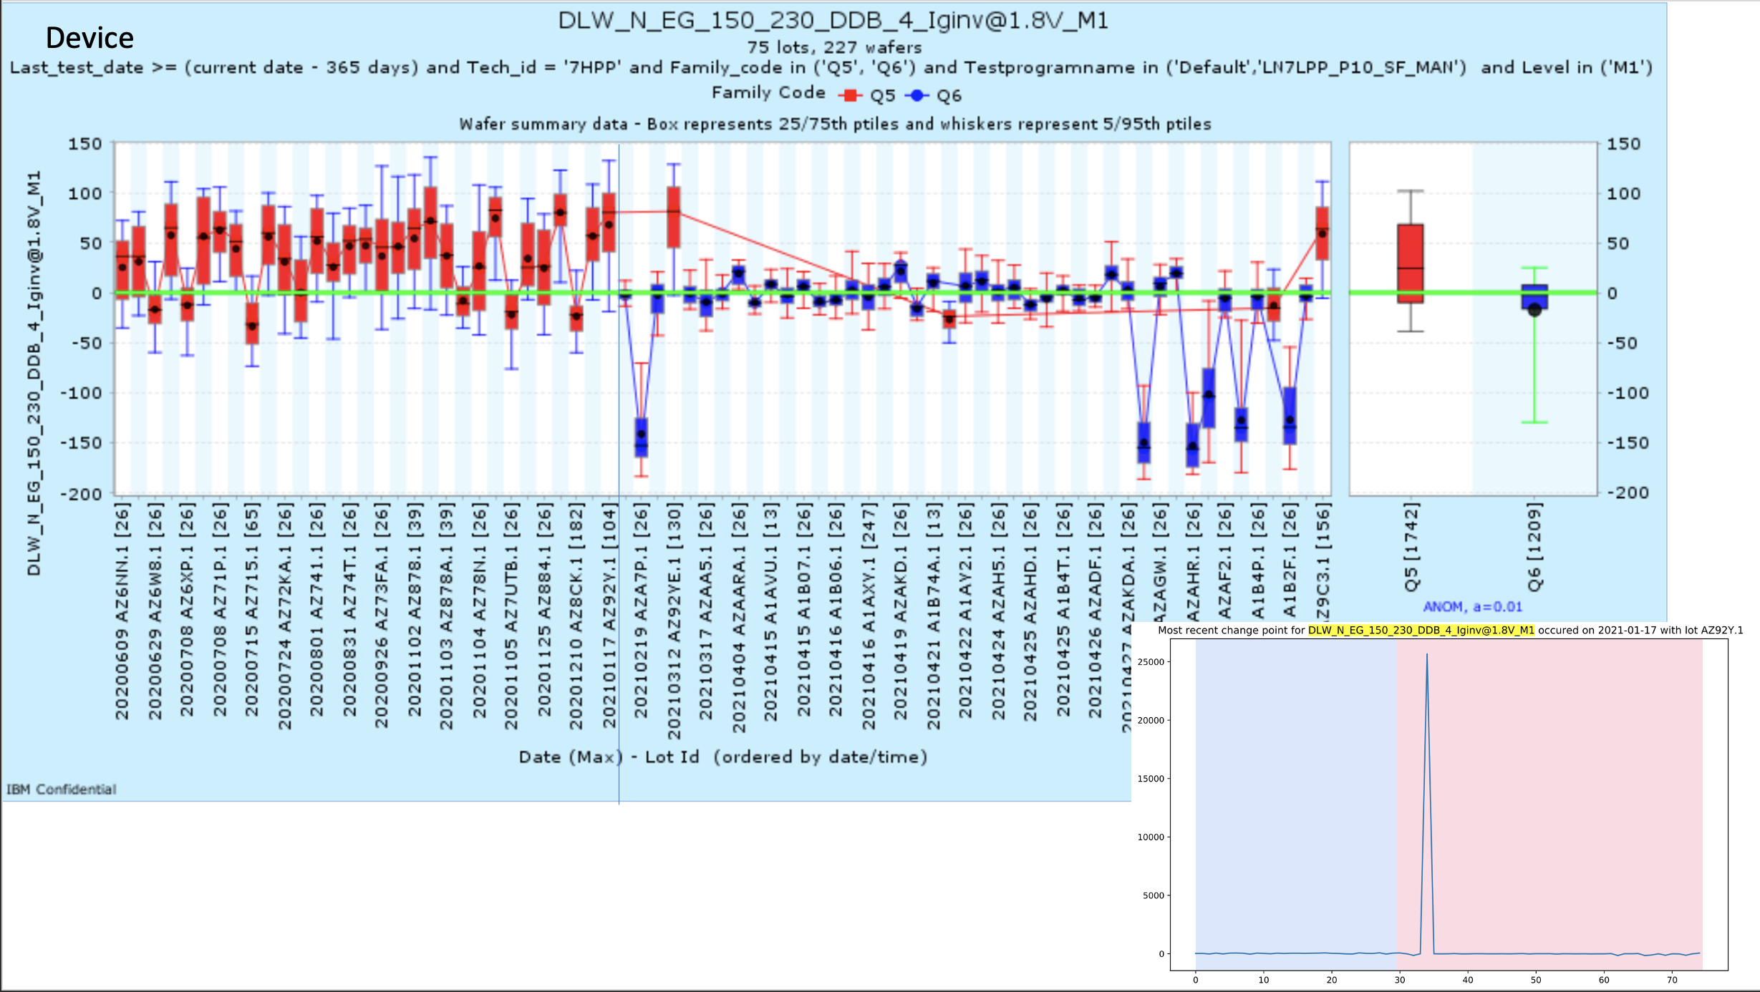
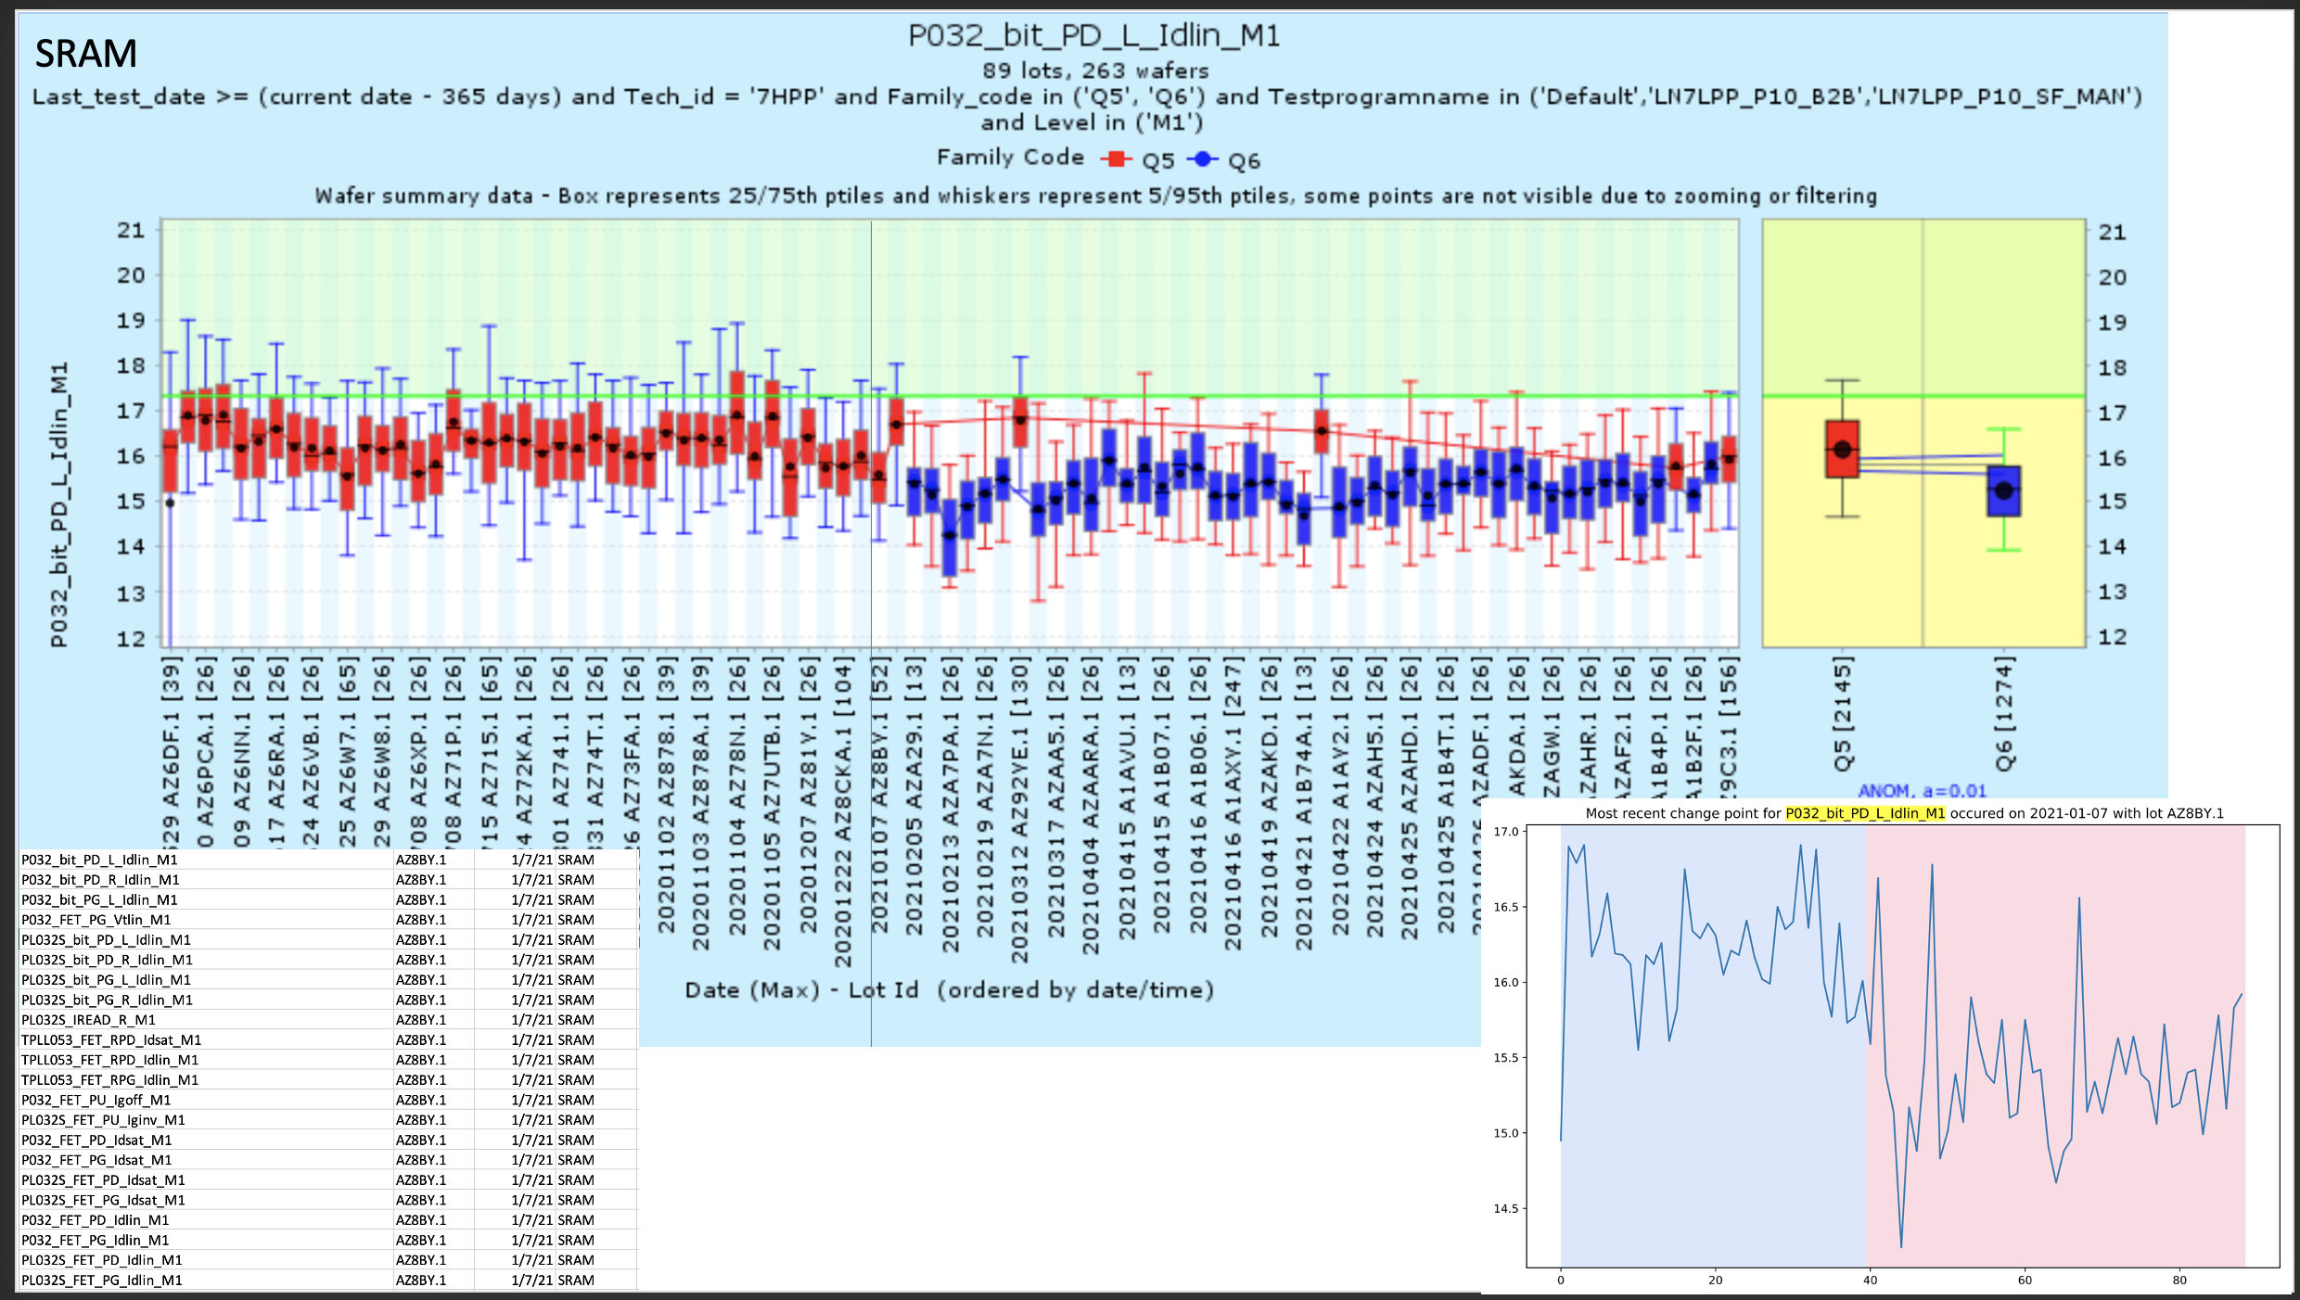
Pain Points with Current Method
After PELT output, I have to manually group similar parameters that move around the same time period so that experts don’t get bombarded with 20+ parameters at a time.
I also need too manually check if the change point is real because the graphical output is not ideal.

Slide 5
Potential Projects
Get from PELT algorithm output to easily digestible result that can be directly handed to experts without requiring any extra work
Topics covered: Data engineering/processing, Data Visualization, Coding in Python, Automation
Apply parallel computing to process multiple parameters at a time
Topics covered: Map/Reduce, Parallel data processing, Maybe Coding in Spark, Working With Virtual Machines or Docker
Come up with your own method for Change Point Detection that works better than current version. Is it possible to develop it from scratch?
Topics covered: Change point detection, Coding in Python

